Slide 1
Medical Diagnosis of Ailments through supervised learning techniques on Auscultatory sounds of the human body
AUSCONSULT

Slide 2
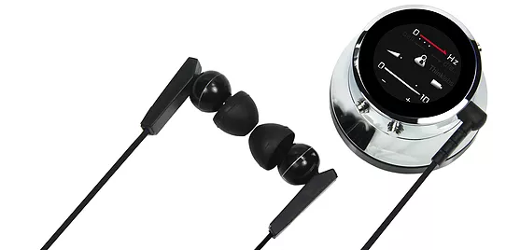
Motivation
Many of the common lung problems along with some critical illnesses (like pneumonia and rheumatic heart disease) could be diagnosed at very early stages by careful stethoscope observations. It would be very helpful if doctors can get guidance on this subject through a digital platform.
A thinklabs-one digital stethoscope (price USD 599)
Some digital stethoscopes, costing from Rs. 6,000 to Rs. 50,000 are available to very wealthy patients and rich doctors. However, even they don't provide a consistent interface to store and share. Because of their price and not much utility, most hospitals don’t spend their budget on digital stethoscopes.
Not much emphasis given to digital methods of auscultation since they are expensive.

Slide 3



Problem Statement
We plan to develop a low cost digital stethoscope and an accompanying android app to store the data on a server and also, suggest illness by a machine learning model developed on collected data so that doctors can get better idea about the diagnosis by auscultation.
+
=

Slide 4

Our Solution
We developed a low cost digital stethoscope and an accompanying android app to store the data on a server.
The user – whether a doctor or a normal person can listen to the heart and lung sounds using our apparatus and simultaneously record these sounds using the android app.
These sound recordings will be available on the firebase server, which can be heard or downloaded.
User can diagnose the sounds to check for illness using the classifier model trained on data collected.

Slide 5
Opinions and support of industry
“Such solutions can help government rapidly reduce health costs and increase the penetration of high edge diagnostics in rural areas.”
– Rucha Aurangabadkar, Student, Govt. Medical College and Hospital, Chiplun, Maharashtra
“Auscultation is a job of an expert doctor, and any tool that can aid in its interpretation coupled with cost-effective method is both pioneering and game-changing in the medical industry”
– Dr. Nilesh Bhadane, General Anaesthesiast,
H N Reliance Hospital, Mumbai
“I shall provide full support and consultation in the design and data collection of this project along with any other help from my colleagues. Such endeavours must always be welcomed.”
– Suneeta, Asst. Medical Superintendent,
SRHC Hospital, Narela, Delhi

Slide 6
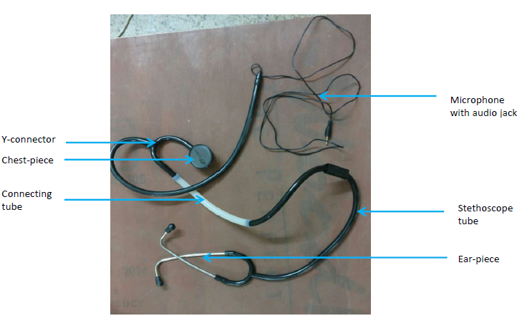
Apparatus
The apparatus consists of chest-piece, ear-piece and a 3.5 mm microphone with audio jack. These three parts are connected with a Y-connector latex tube and another tube with larger diameter to join one end of Y-connector to the stethoscope tube for the ear-piece. This enables recording of sound with the mic while listening through the earpiece.

Slide 7
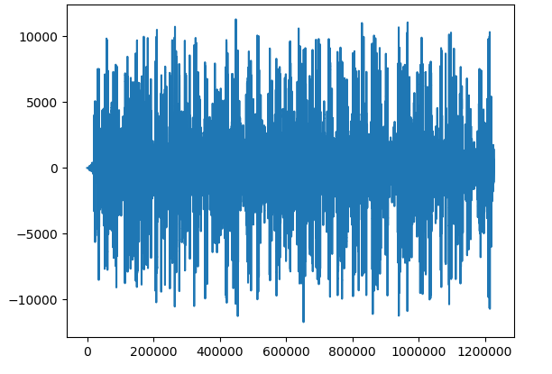
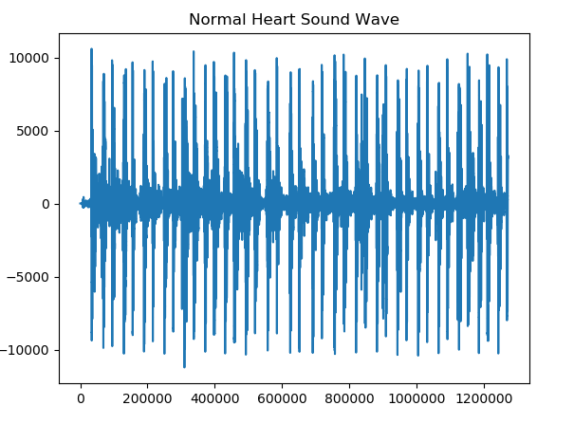

Comparison of quality of sounds recorded
Final recording from improved stethoscope
Initial phase recording
Signal Amplitude (x10⁻⁵ m)
Time (x10⁻⁵ sec)

Slide 8
Input Dataset for comparing classifiers
Since the actual data gathering would be taking some time to acquire from hospitals, we have an online repository of audio files that contained auscultatory sounds of heart. The audio files contained data tagged as one of the following 4 categories as suggested by medical experts. This dataset is gathered from a clinic trial in hospitals using the digital stethoscope.
Normal Heart Sound
Murmur Heart Sound
Extra Heart Sound
Artifact in Signal
A brief description of each of the categories is given in the following slides.

Slide 9
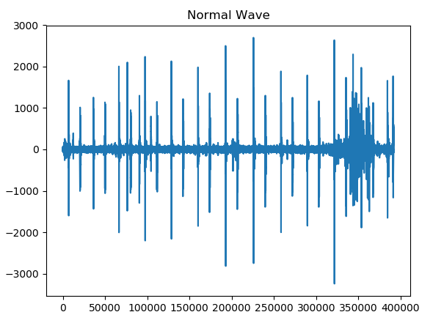
Normal Heart Sound
Signal Amplitude (x10⁻⁵ m)
In the Normal category there are normal, healthy heart sounds. These may contain noise in the final second of the recording as the device is removed from the body. A normal heart sound has a clear “lub dub, lub dub” pattern, with the time from “lub” to “dub” shorter than the time from “dub” to the next “lub” (when the heart rate is less than 140 beats per minute). Note the temporal description of “lub” and “dub” locations over time in the following illustration:
…lub……….dub……………. lub……….dub……………. lub……….dub……………. lub……….dub…
Time (x10⁻⁵ sec)

Slide 10
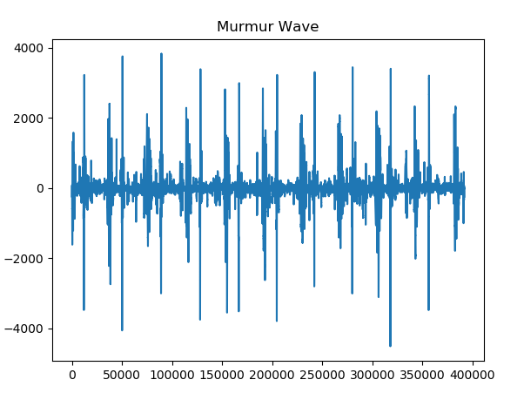
Murmur Heart Sound
Signal Amplitude (x10⁻⁵ m)
Heart murmurs sound as though there is a “whooshing, roaring, rumbling, or turbulent fluid” noise in one of two temporal locations: (1) between “lub” and “dub”, or (2) between “dub” and “lub”. They can be a symptom of many heart disorders, some serious. There will still be a “lub” and a “dub”. One of the things that confuses non-medically trained people is that murmurs happen between lub and dub or between dub and lub; not on lub and not on dub. Below, you can find an asterisk* at the locations a murmur may be.
…lub..****...dub……………. lub..****..dub ……………. lub..****..dub ……………. lub..****..dub …
Time (x10⁻⁵ sec)

Slide 11
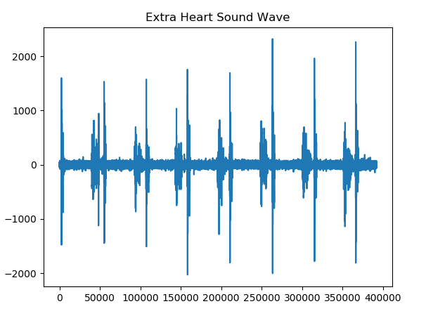
Extra Heart Sound
Signal Amplitude (x10⁻⁵ m)
Extra heart sounds can be identified because there is an additional sound, e.g. a “lub-lub dub” or a “lub dub-dub”. An extra heart sound may not be a sign of disease. However, in some situations it is an important sign of disease, which if detected early could help a person. The extra heart sound is important to be able to detect as it cannot be detected by ultrasound very well. Below, note the temporal description of the extra heart sounds:
…lub.lub……….dub………..………. lub. lub……….dub…………….lub.lub……..…….dub…….
or
…lub……….dub.dub………………….lub.……….dub.dub………………….lub……..…….dub. dub……
Time (x10⁻⁵ sec)

Slide 12
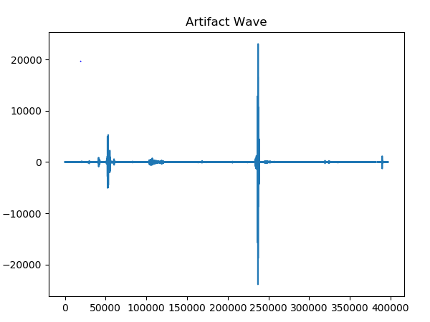
Artifacts in Signal
Signal Amplitude (x10⁻⁵ m)
In the Artifact category there are a wide range of different sounds, including feedback squeals and echoes, speech, music and noise. There are usually no discernible heart sounds, and thus little or no temporal periodicity at frequencies below 195 Hz.
These audio signal correspond to outliers in the data.
Time (x10⁻⁵ sec)

Slide 13
Classification of Heart Sounds
The following classifiers have been used:
Support Vector Machine (SVM)
Neural Network
Convolutional Neural Network
K-Nearest Neighbour(KNN)
Random Forest Classifier
Extra Trees Classifier
Gradient Boosting Classifier
Recurrent Neural Network

Slide 14
Analysis of Classifiers tested in previous semester
Classifier | F1-Score | Accuracy
NN | 77.8 | 77.8
Extra Trees | 74.1 | 76.4
Random Forest | 74.1 | 75.4
SVM | 71.8 | 74.7
Gradient Boosting | 73.2 | 73.7
kNN | 67 | 70.3
CNN | - | 65
RNN | - | 61.9

Slide 15
Predicting Diagnosis on sounds recorded through our app

Slide 16
Although all the classifiers were successfully tested, a diagnosis out of real world data was yet to be done.
The app is integrated with the classifier to diagnose. For this, following steps are performed –
Sounds are recorded from the app using the apparatus.
This data is uploaded on Firebase storage and also to Cloud9 server.
Python script for classifying the sounds is run on Cloud9 server using the recorded sounds.
Result of diagnosis is sent back to the app

Slide 17
Input Dataset for actual diagnosis
The data collected using our apparatus is 4 point dataset instead of just the heart sounds and is classified into one of the following classes –
1. Mild Bronchospasm
2. Mild Wheez
3. Normal
4. Portal Hypertension

Slide 18
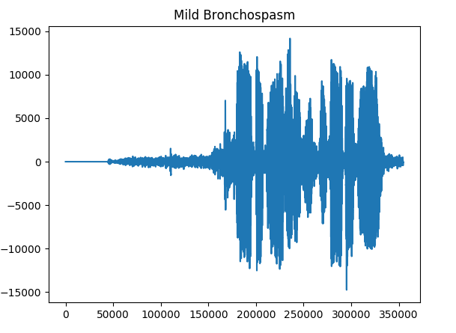
Mild Bronchospasm
Bronchospasm or a bronchial fit is a sudden choking of the muscles in the dividers of the bronchioles. It causes trouble in breathing which can be exceptionally gentle to serious.
Accompanying signs and side effects: Shortness of breath, Tightness of chest, Wheezing, or a hack that keeps you conscious around evening time. The following is the sound wave representation of accounts from one of the patients.

Slide 19
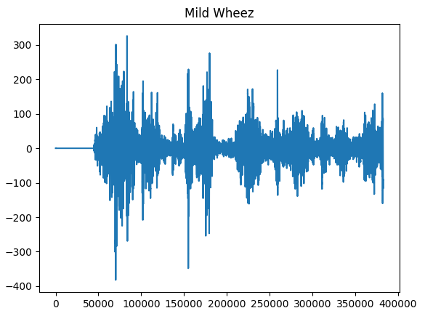
Mild Wheez
Wheezing is a shrieking sound that happens amid breathing when the aviation routes are limited.
The sound is caused via air that is constrained through aviation routes that are smaller than typical. The following is the sound wave representation of accounts from one of the patients.

Slide 20
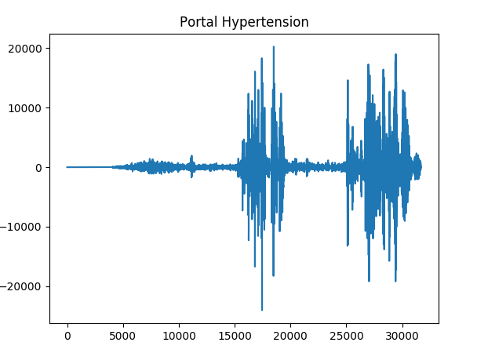
Portal Hypertension
Also called as postural hypertension, it is a medicinal condition where pulse falls quickly after the body changes position most usually happening in the wake of standing up in the wake of sitting for drawn out stretches of time.
Patients with postural hypertension encounter manifestations of low circulatory strain when the condition happens. The following is the visual portrayal of this classification of sound.

Slide 21
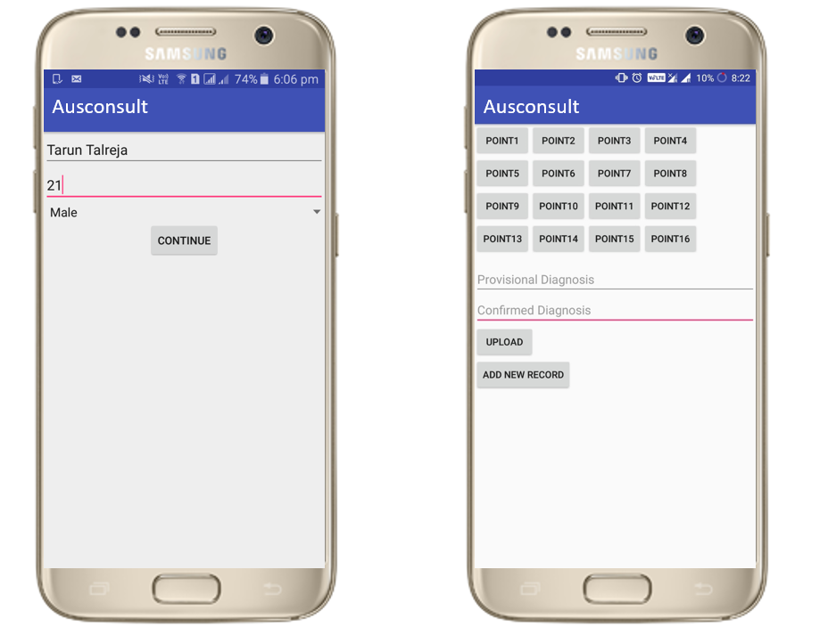
Data Collection
Each sample has 4 audio recordings, one each from right lung (top & bottom) and left lung (top & bottom)
The samples were obtained from normal test subjects as well as patients suffering from illnesses like mild bronchospasm, mild wheez and portal hypertension.

Slide 22
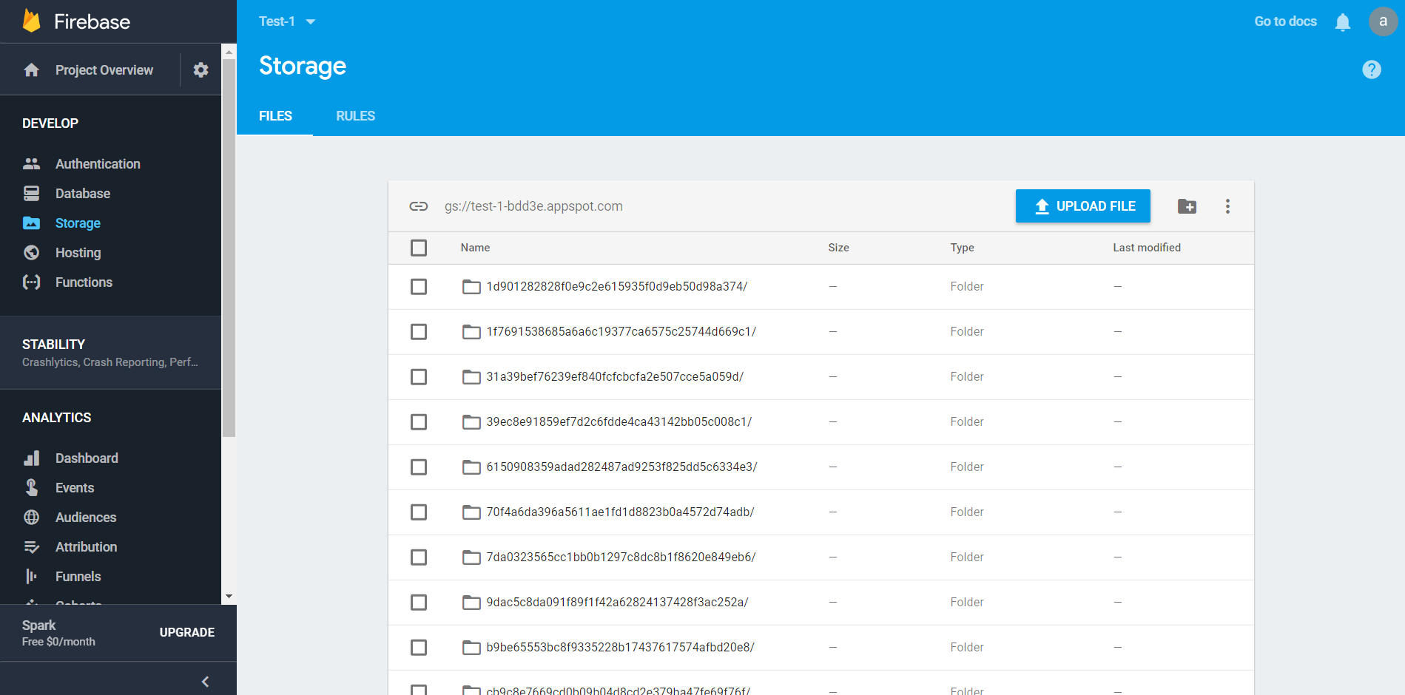
Data Collection and uploading on Firebase

Slide 23
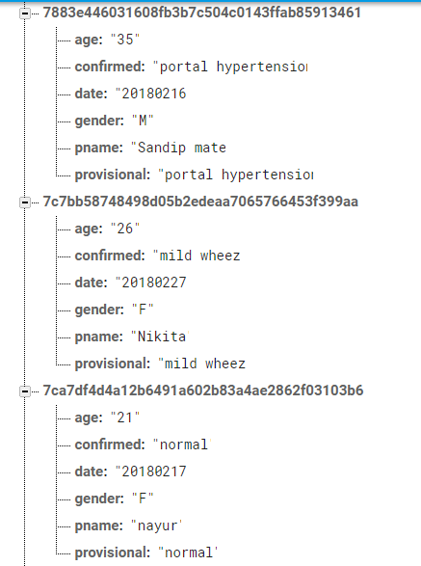
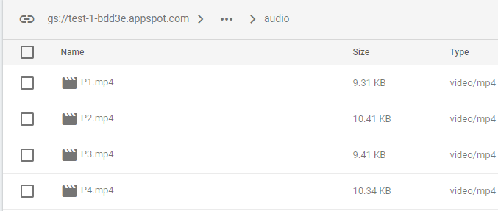

Slide 24
Single point Diagnosis
After training the classifiers, it is required that when a particular sound file is recorded through the app, it is classified using the already trained models and diagnosed for illness. So, we applied the following logic for single point diagnosis –
Send the following as arguments to the function for single point diagnosis –
Path to the audio file
Name of the trained model to be used
The type of classifier
Classify the sound using the specified model by retrieving it from storage.
Output the respective weights assigned to each of the classes denoting the probability of the sample belonging to those classes

Slide 25
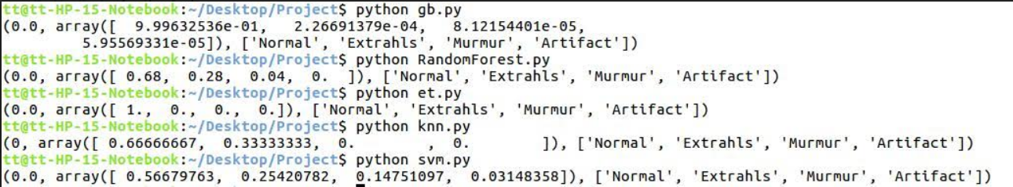
Sample output of single point diagnosis
Output is of the form : (index, array of weights) where,
Index : index of class to which it is classified because of maximum weight
Array of weights : array denoting the probabilities of the sample belonging to each class

Slide 26
Modification to the single point classifier
Our input dataset contains 4 points for every patient. Thus, we modified our single point classifier to test all 4 points and give the result, which is the name of the illness or normal. This modification was carried out as follows –
Take all 4 points sound recordings as input.
Apply single point classification separately on each point.
Obtain the resulting array of probabilities indicating which class each sound belongs to.
Take average of the 4 arrays to get a resulting array with average probabilities and finally obtain the class which has the maximum probability.

Slide 27
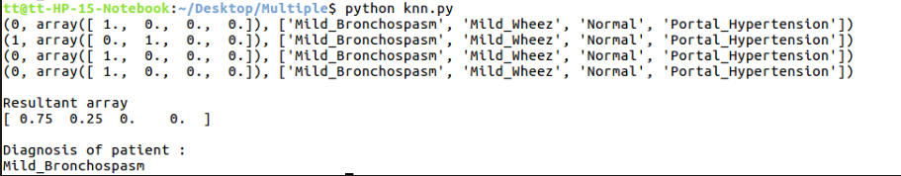
Multiple point Diagnosis
A sample containing 4 point sounds of the class Mild_Bronchospasm is classified using the multiple point classifier. The results are the 4 arrays denoting probabilities of each point belonging to the different classes and the resultant array denoting the average probability. The sample is correctly classified as Mild_Bronchospasm.

Slide 28
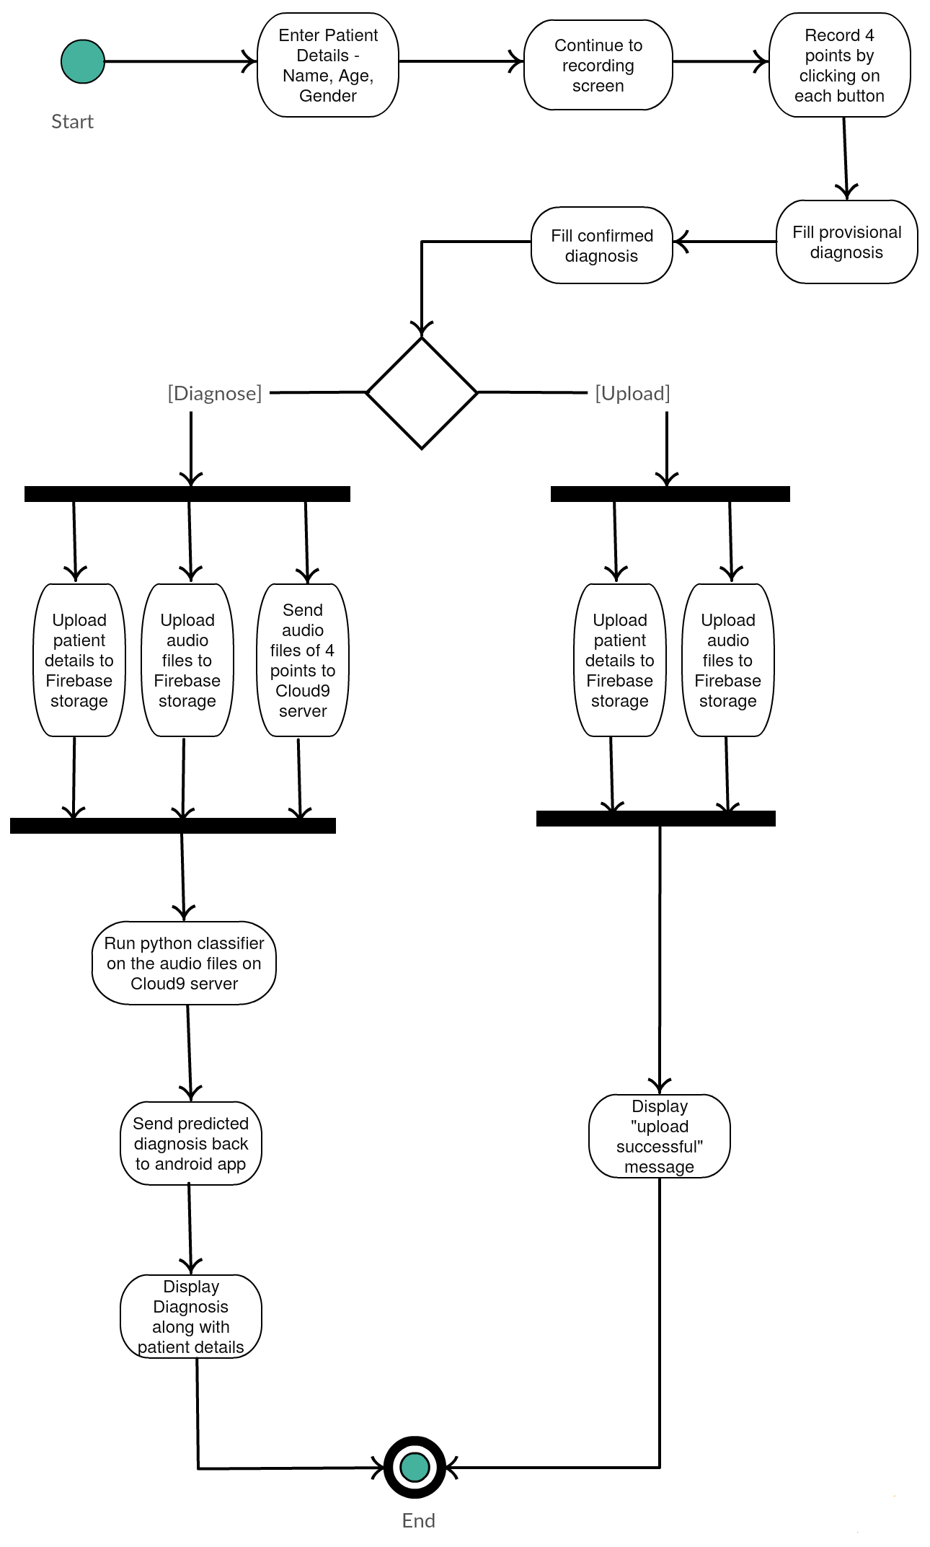
Activity Diagram of the system

Slide 29
Some Snapshots of our project

Slide 30
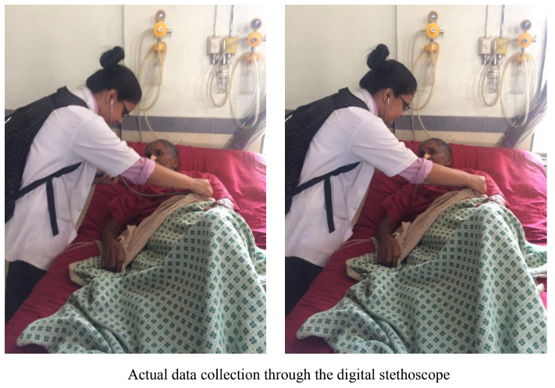

Slide 31
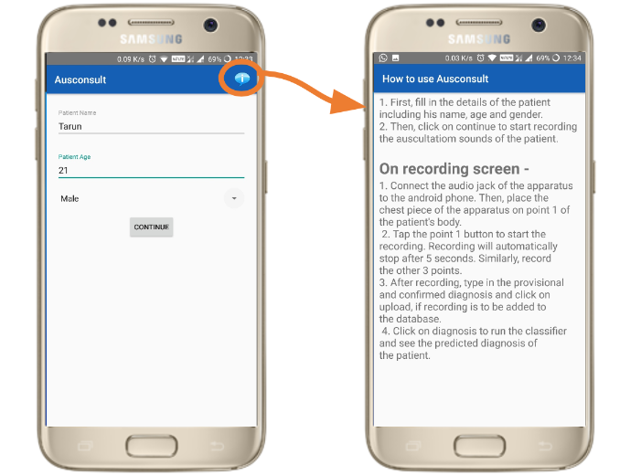

Slide 32
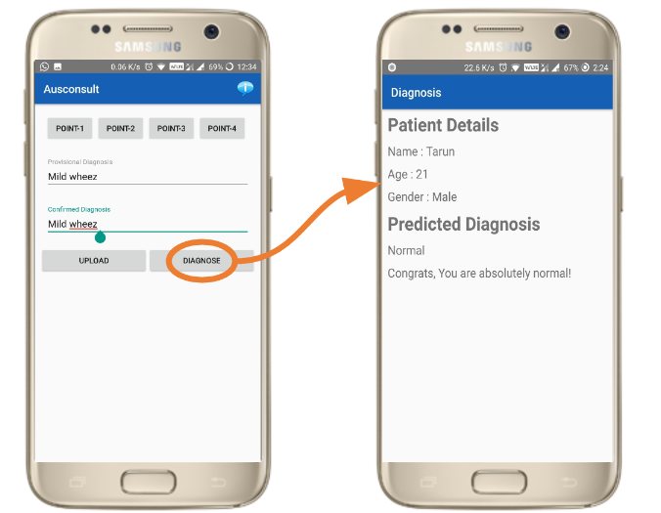

Slide 33
Scalability of the model
This model can be easily extended to classify any number of points together – 4,8,16.
This is because, the algorithm for multiple point classification as applied to 4 point classification as of now can be modified for more points by only changing the number of inputs in the code.
If the doctors/medical students are able to start collecting data of more points for each patient, the code is capable of adapting to it.

Slide 34
Conclusion
We are now successfully able to diagnose and classify three major respiratory/pulmonary disorders namely bronchospasm, wheezing and hypertension along with ascertaining whether a patient is normal or not.
This project has been a revelation also with respect to our knowledge and understanding of telemedicine.

Slide 35
Future scope
Apart from recording the sounds and storing the audio files in Firebase Storage, the android app will also integrate the classifier and predict the illness for the patient.
We will also try to analyse the collected data to provide insights on traits like age-group, gender and location.

